Slide 1
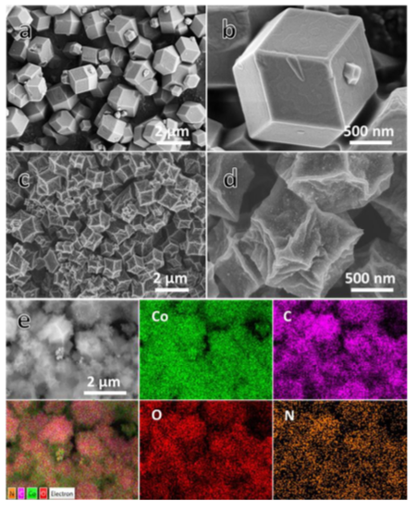
Cobalt nanoparticles embedded in porous N-rich carbon as an efficient bifunctional electrocatalyst for water splitting
Xingyue Li, et al Royal Society of Chemistry, DOI: 10.1039, 2012.
They exploit the unique composition and structure of Co- based zeolitic imidazolate framework (ZIF-67) as a precursor to synthesize the cobalt nanoparticles (NPs) embedded in porous N-rich carbon (PNC/Co). The resulting PNC/Co performs as a bifunctional catalyst that has high activity towards both the HER and OER in strongly alkaline media. In 1.0 M KOH electrolyte, the PNC/Co achieves small overpotentials at a current density of 10 mA cm-2 and yields high Faradaic efficiency towards both the HER and OER.
In Figs. 1a and 1b show the scanning electron microscopy (SEM) images of ZIF-67 crystals before carbonization. It reveals that the as synthesized ZIF-67 crystals possess a regular rhombic dodecahedral morphology composed of well-defined rhombus faces and straight edges.
The energy dispersive X-ray spectroscopy (EDS) of the PNC/Co (Fig. S2, ESI†) reveals the coexistence of C, N, O and Co with a mass fraction of 45.14%, 4.38%, 17.23% and 33.25%, respectively.
The presence of oxygen species could be resulted from superficial oxidation of cobalt in air.
The corresponding SEM-EDS elemental mapping reveals the homogenous distribution of these elements species (Fig. 1e) in the PNC/Co.
After the OER stability tests, we performed SEM, HRTEM, XRD and XPS characterizations to understand the OER performance of the PNC/Co. SEM and TEM observations (Fig. S6, ESI†) results indicate that the PNC/Co basically preserves original profiles after cycling test in alkaline condition.
Fig. 1 SEM images of the ZIF-67 (a,b) and PNC/Co (c,d). SEM- EDS elemental mapping images (e) of the PNC/Co.

